Slide 1

E-Commerce: The trend of Digital Goods in the AOL Dataset 2006
Ebna Sina Krishnakumar Mudaliar Chimagbanwe Umeh Ravi Pandit Sunbla Khan
Business Intelligence
M.Sc. Data Science December 08, 2025

Slide 2
E-commerce on Digital goods
Intangible Products: Digital goods are non-physical items (e.g., software, music, e-books, subscriptions) sold and delivered purely over the internet.
Unique Economics: Characterized by a zero marginal cost (nearly free to produce additional units) and instant global distribution, leading to high-profit margin potential.
Historical Pivot: The Q2 2006 period represents the crucial phase where the market pivoted from physical media (CDs, DVDs) to digital downloads and early subscription models, establishing today's digital economy foundations.

Slide 3
Analysis Progression
Define Market Volume
Establish the overall volume and trend of high-intent digital searches across the entire three-month period
Segment User Intent
Analyse high-intent (CTR) patterns by breaking down activity across Category, Hour, and Day
Rank Top Domains
Determine the Top 5 most clicked domains within each digital product category to establish the competitive landscape
Validate Market Stimulus
Correlate search spikes with 10 external market event dates to confirm the external impact on user behavior
Correlate Financial Confidence
Compare the smoothed AOL search trend (Internal Signal) with AAPL/EBAY stock prices to identify a potential leading indicator

Slide 4
QUESTION 1
What was the overall volume and trend of digital content-related searches across all weeks, and what was the total contribution by month?

Slide 5

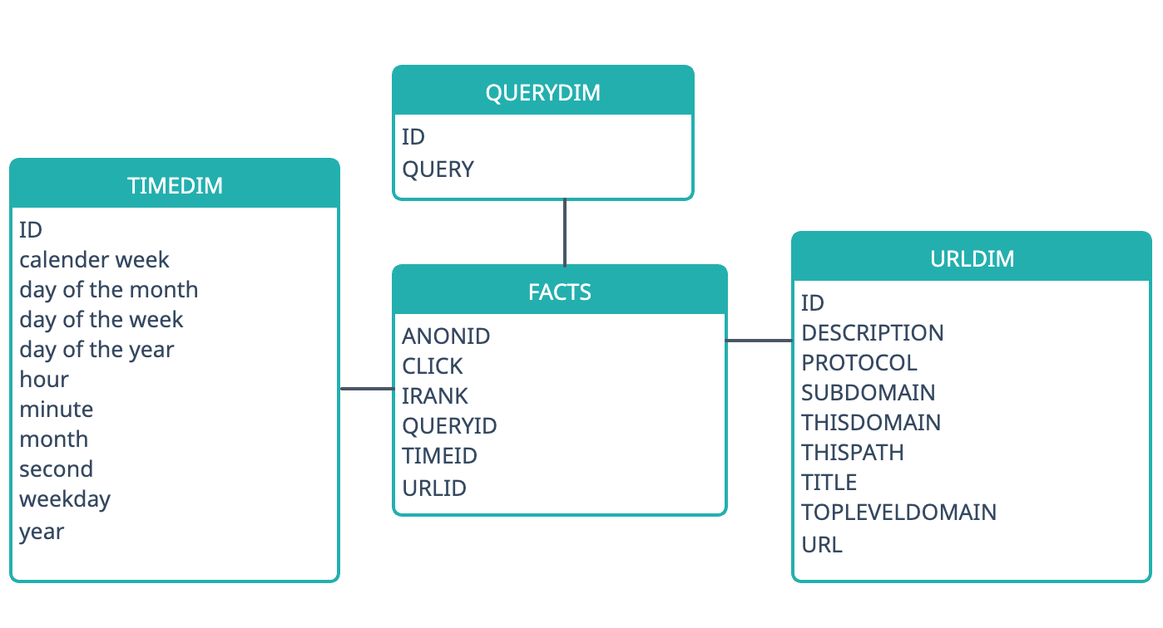
Initial Star Schema

Slide 6
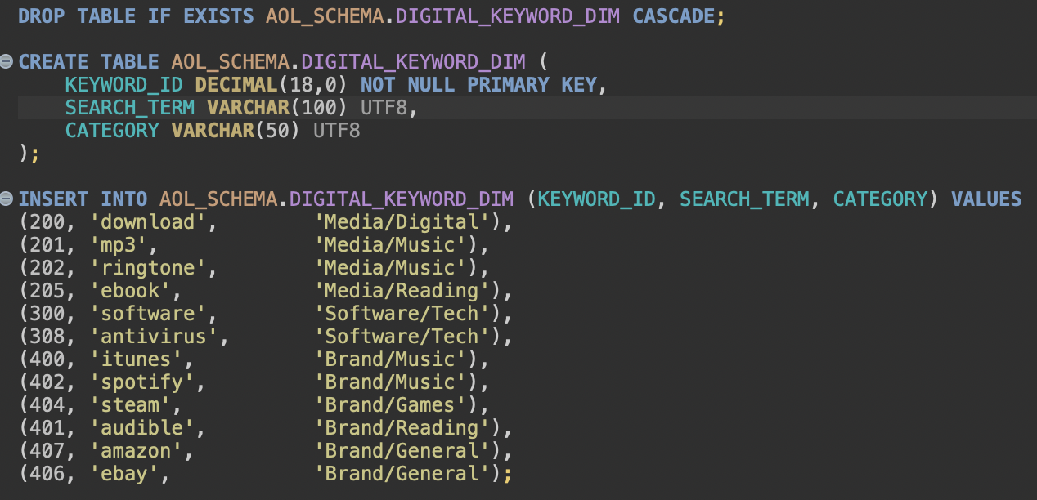
Q1: Volume analysis of digital content-related searches
Define the keywords used for querying the term "digital content" and their Category in a table DIGITAL_KEYWORD_DIM

Slide 7
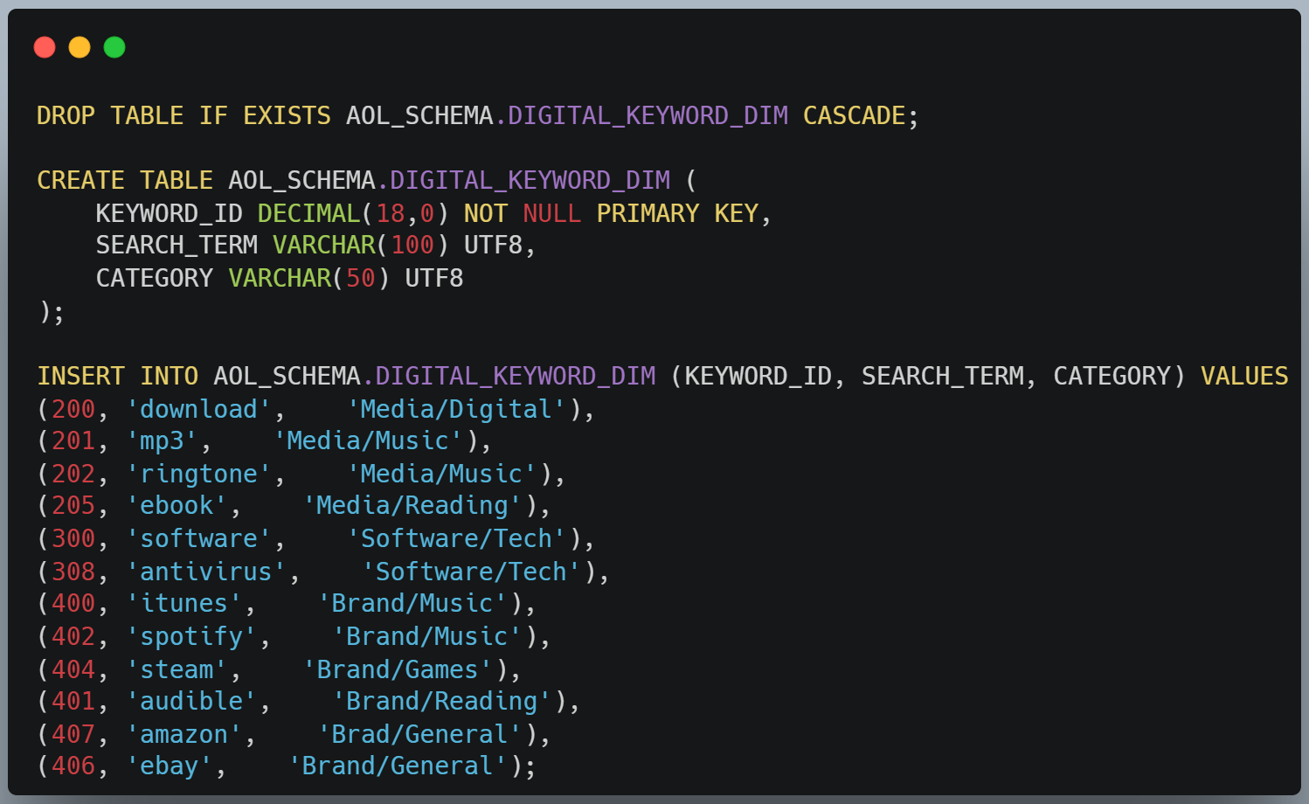
Q1: Volume analysis of digital content-related searches
Define the keywords used for querying the term "digital content" and their Category in a table DIGITAL_KEYWORD_DIM

Slide 8
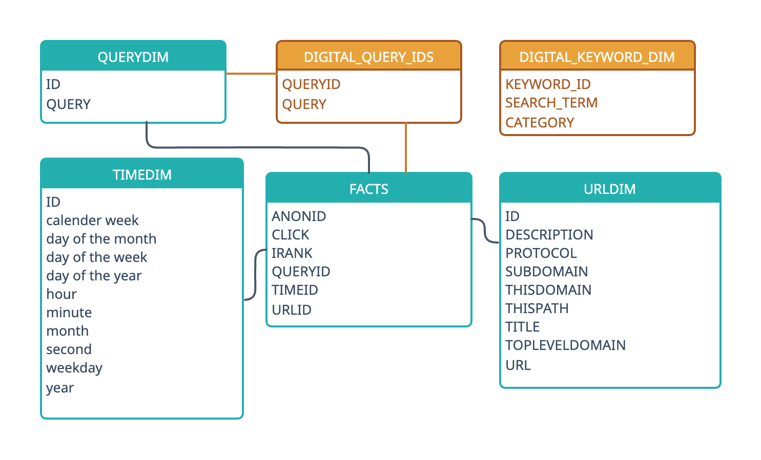
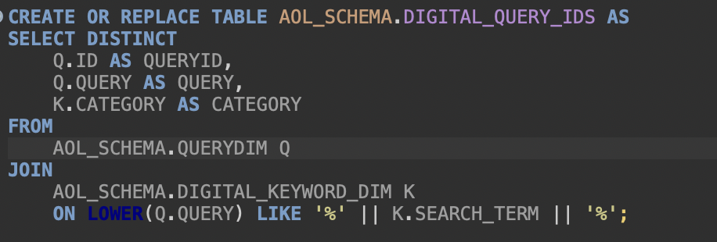
Extends Schema to create a Materialize view of the related query IDs
DIGITAL_QUERY_IDS: hold queries on digital content for faster query with FACTs, about 68,380 records, instead of 10 million total records from the QUERYDIM table.

Slide 9
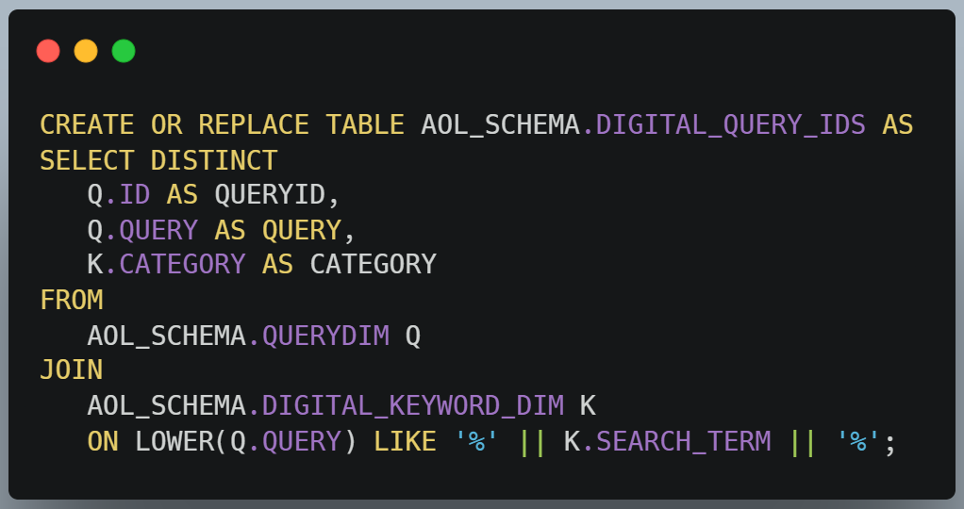
Extends Schema to create a Materialize view of the related query IDs
DIGITAL_QUERY_IDS: hold queries on digital content for faster query with FACTs, about 68,380 records, instead of 10 million total records from the QUERYDIM table.

Slide 10
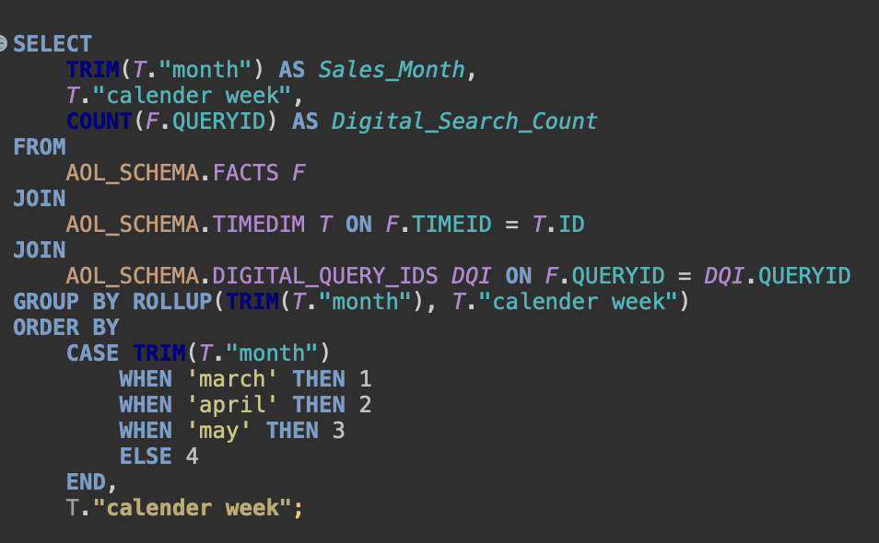
Q1: Volume analysis of digital content-related searches
Join TIMEDIM and DIGITAL_QUERY_IDS
Group by Month and week using ROLLUP to get the break-downs
Order by Month also making sure the month is sorted well

Slide 11
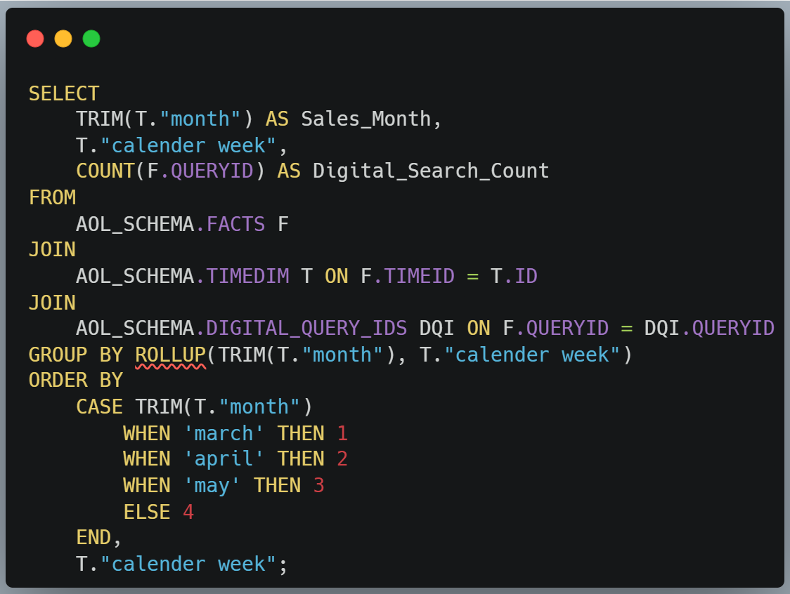
Q1: Volume analysis of digital content-related searches
Join TIMEDIM and DIGITAL_QUERY_IDS
Group by Month and week using ROLLUP to get the break-downs
Order by Month also making sure the month is sorted well

Slide 12
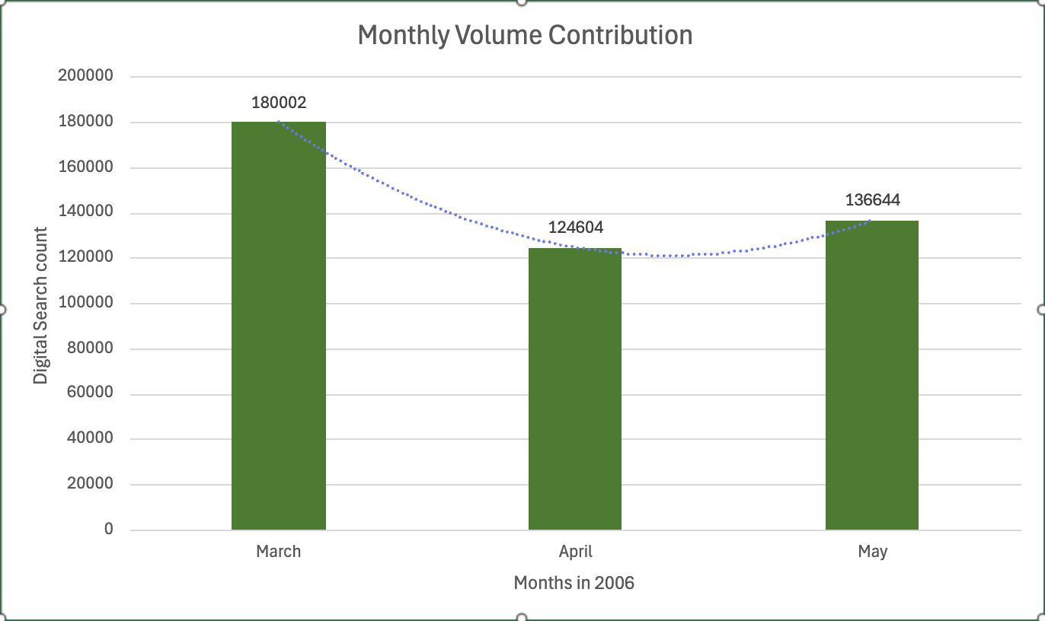
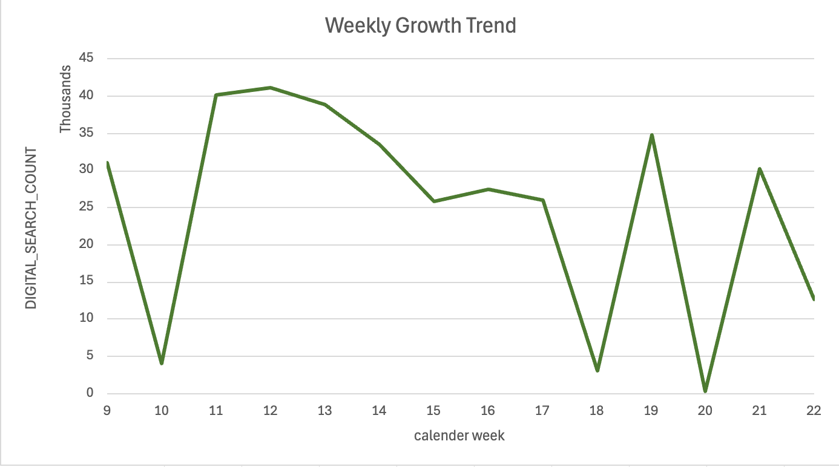
Q1: Visualization of the search volumes
Monthly totals
Weekly Trend

Slide 13
QUESTION 2
Which specific digital commerce categories (Music/Media, Software, Brands) drove the highest click-through rate (CTR), and how did the user search volume and intent compare based on the hour and day of the week?

Slide 14
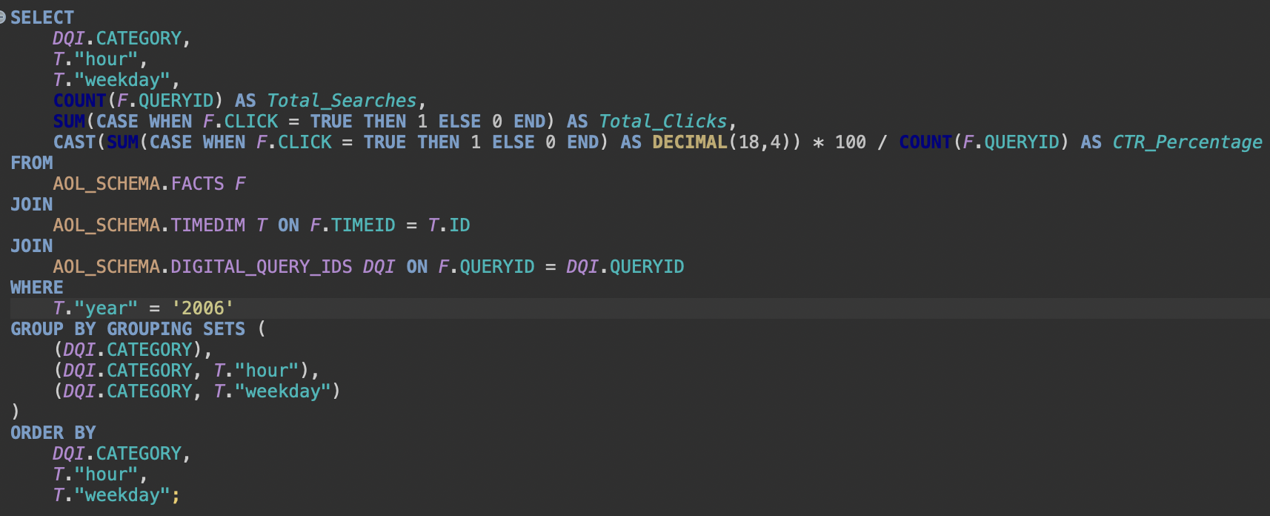
Q2: Rank the digital commerce categories by user intent (CTR)
Group by using Grouping sets across 3 dimensions

Slide 15
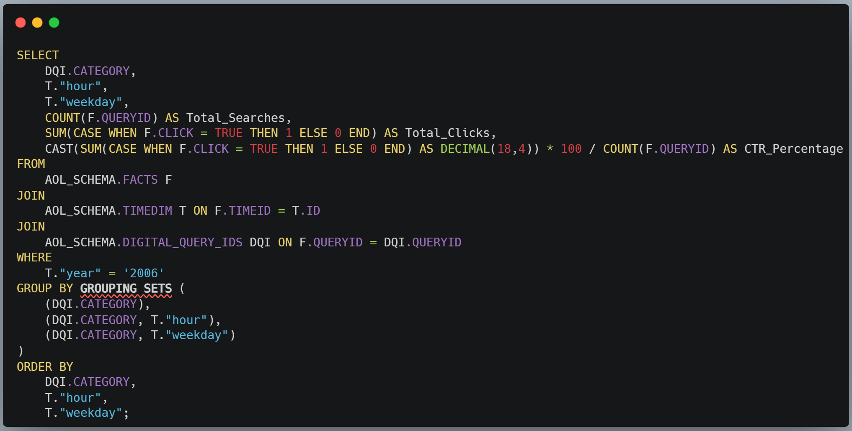
Q2: Rank the digital commerce categories by user intent (CTR)
Group by
using
Grouping sets across
3 dimensions

Slide 16
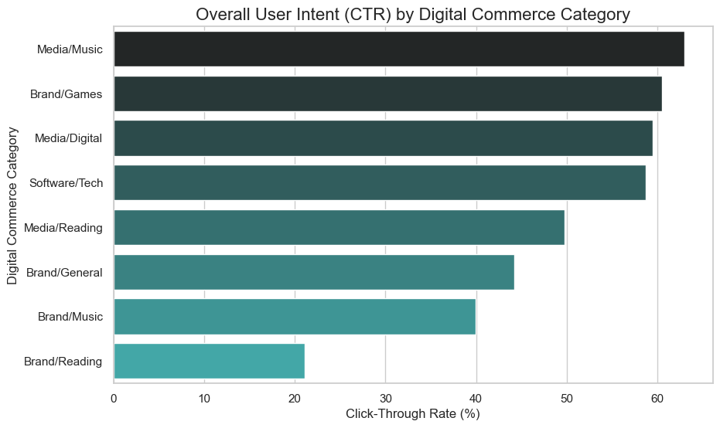
Q2: Overall Category Intent (Grouping Set: Category only)
Media/Music has the highest Click-through-Rate.
Followed by Brand/Games

Slide 17
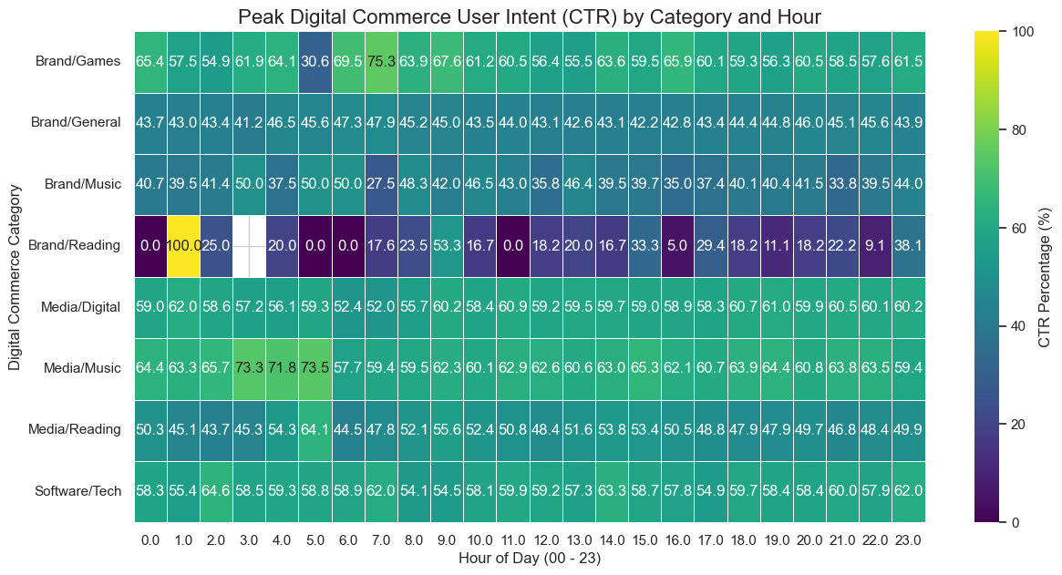
Q2: Peak Behavioral by Hour Shows when users search for and click on digital goods, revealing early morning like for music

Slide 18
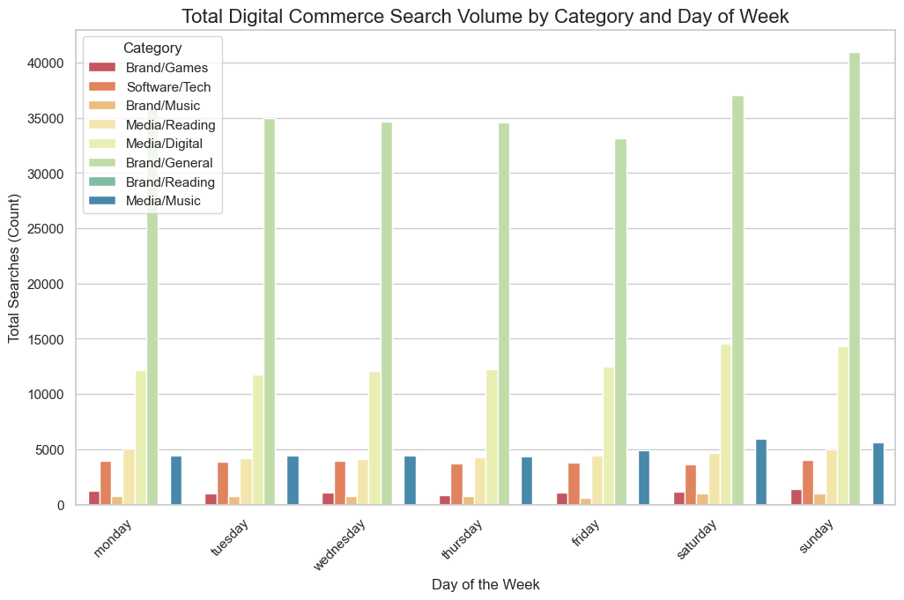
Q2: Peak Behavioral by Day Compares digital commerce activity across the days of the week, more searches happened on the weekends.

Slide 19
QUESTION 3
What were the Top 5 most popular destinations (Domains) clicked by high-intent digital commerce searchers, ranked within each category (Music/Media, Software, Brands), and how often did those domains appear at the top?

Slide 20
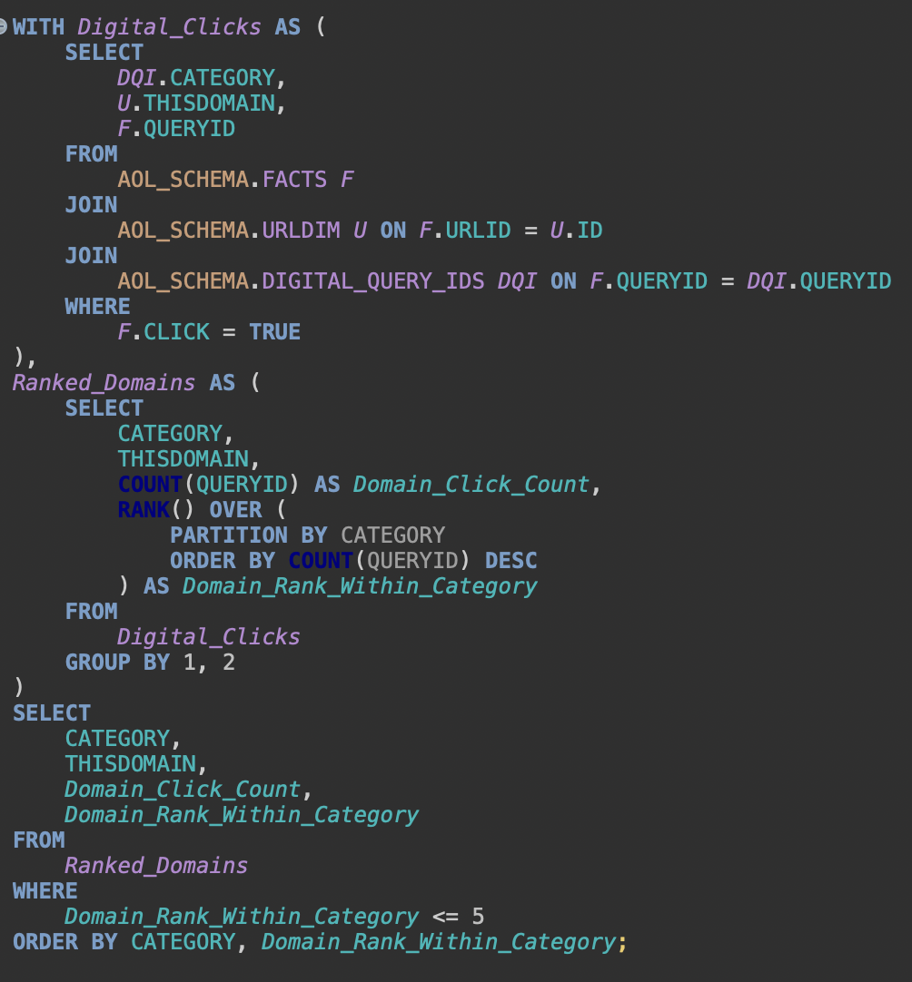
Q3: Top 5 Domains Clicked by Category
Use CTE to get Digital_Clicks and the Ranked_Domains
Window function RANK to rank the domains based on the number of clicks partitioning by Category
Select the TOP 5 domains in each category
Notes:
CTE means common table expression

Slide 21
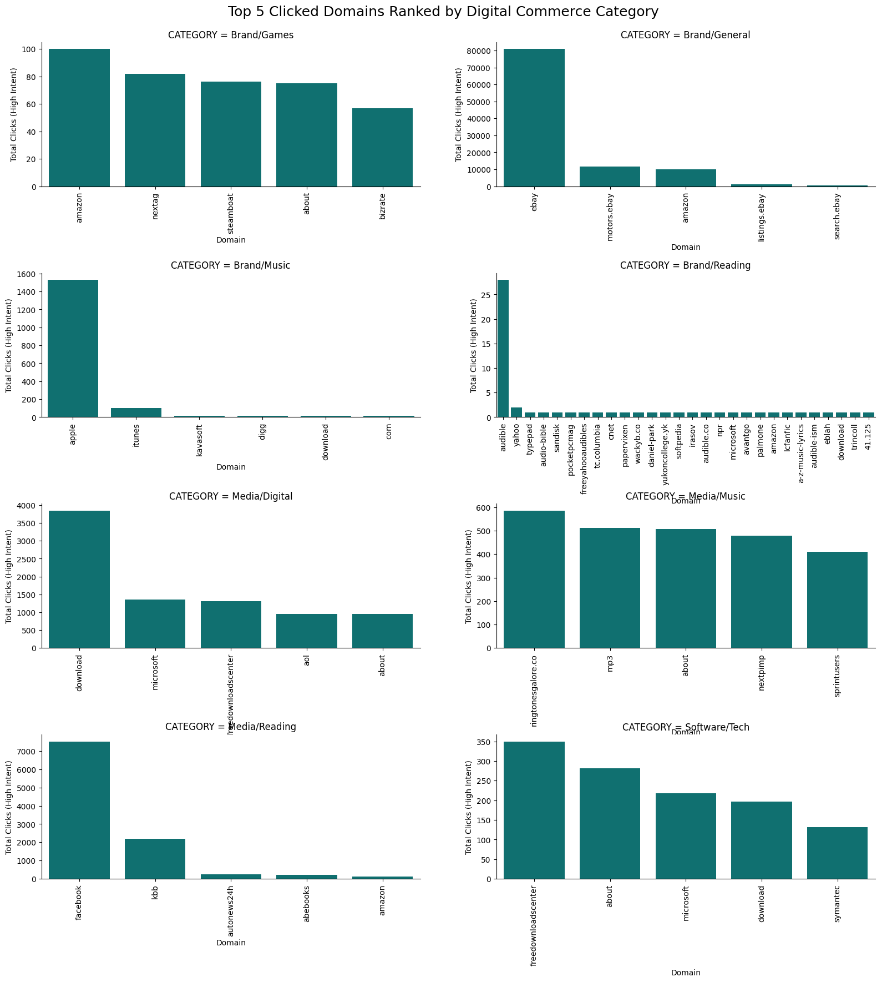
Q3: Competitive Landscape Insights
Extreme Centralization: The Brand/Music category is dominated by Apple (iTunes), capturing nearly all high-intent clicks, indicating an early monopoly on digital media access.
General Volume & Leader: The Brand/General category (led by eBay) shows the highest overall click volume, but its closest competitors are tiny in comparison.
Fragmentation & Emergence: The Software/Tech market is highly fragmented with no clear leader, while Facebook surprisingly leads the high-intent clicks for the Media/Reading category.

Slide 22
QUESTION 4
To what extent did key digital commerce product launches or market announcements serve as a demonstrable stimulus for changes in search volume for related brands during the March–May 2006 period?

Slide 23
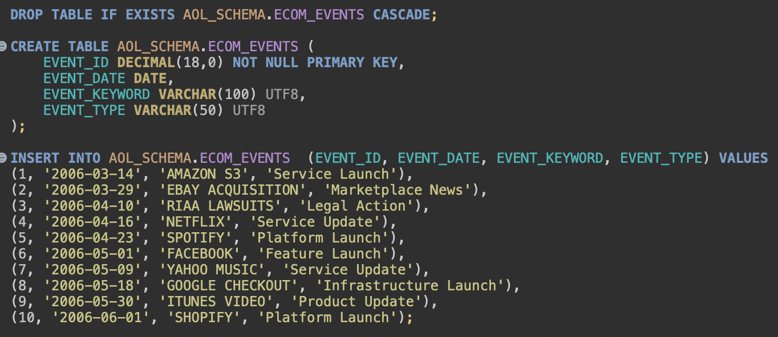
Q4: Real-World Event Correlation
ETL Process for real world events ecommerce that happened around March to May 2006
ECOM_EVENTS table hold some major events that happen between the period of March to May 2006.
Data Source: Google search

Slide 24
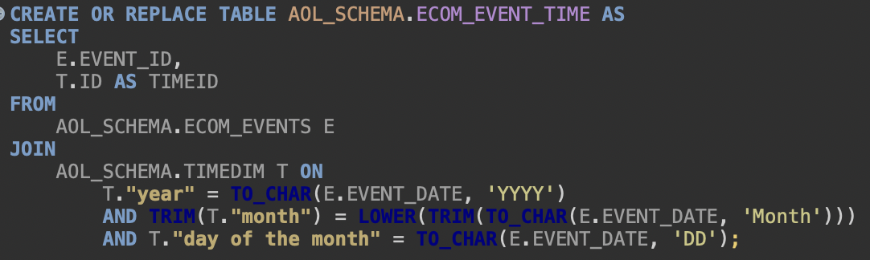
Q4: Real-World Event Correlation
ETL Process for real world events ecommerce that happened around March to May 2006
ECOM_EVENT_TIME table hold a many to many relationship between the ECOM_EVENTS and the TIMEID

Slide 25
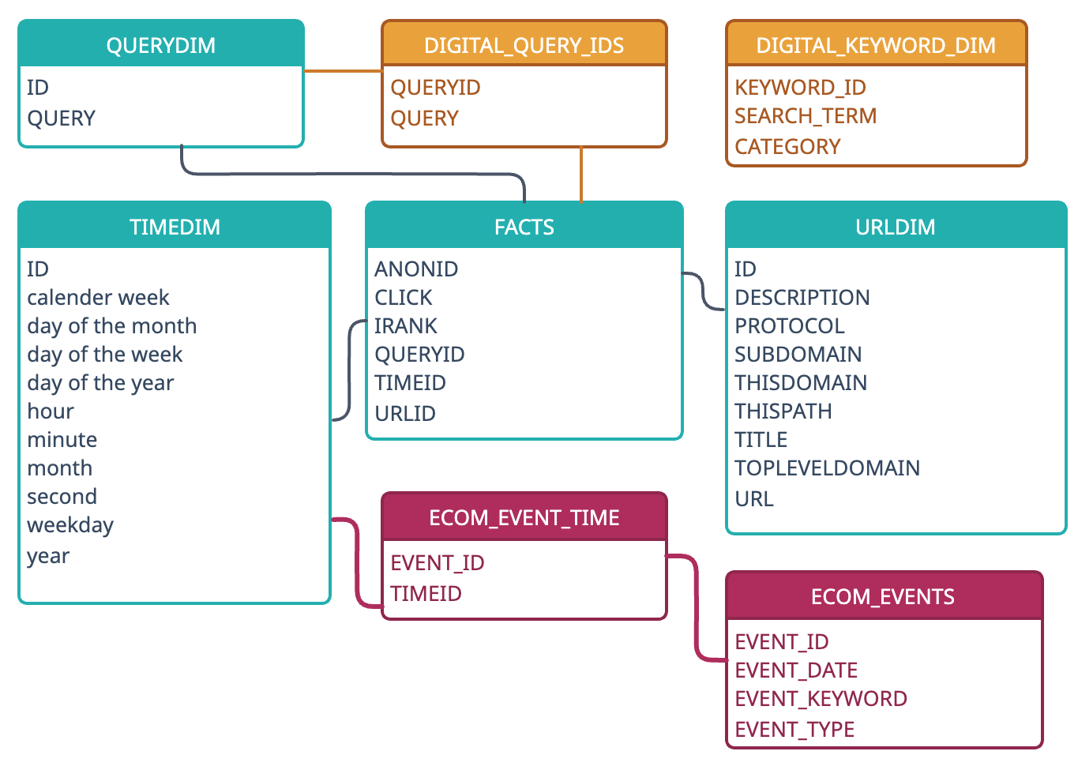
Q4: Extended Schema with real world events

Slide 26
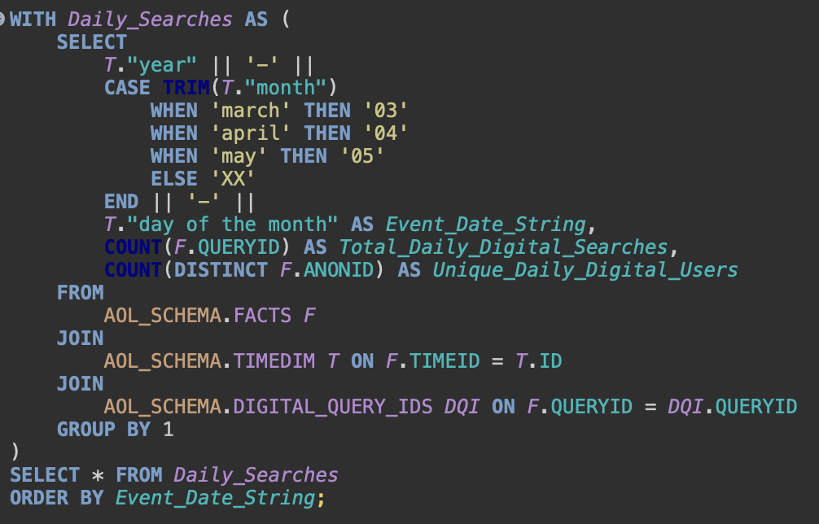
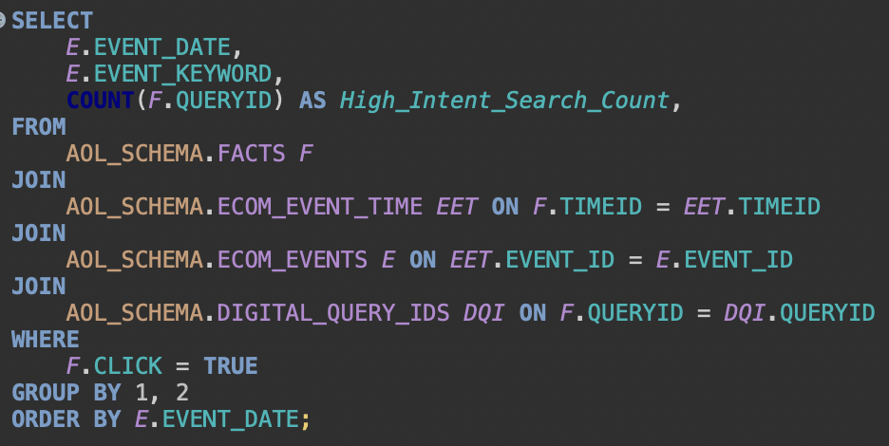
Q4: Real-world Event Correlation
Gets the daily search volume for digital content-related searches
Gets the total searches that happened on the real-world events date

Slide 27
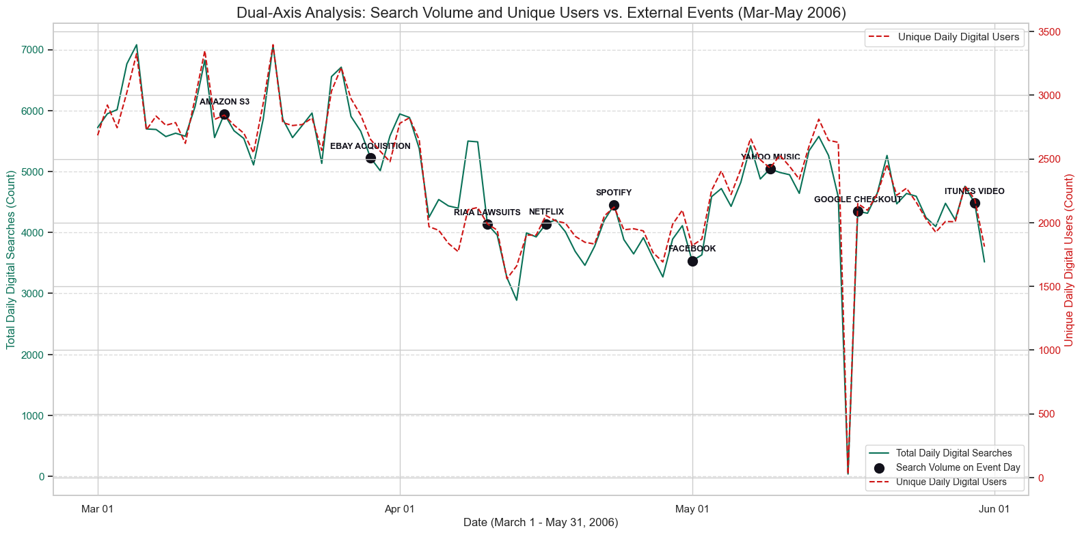
Q4: Real-world Event Correlation with daily search

Slide 28
QUESTION 5
What was the most significant indicator from the AOL search data—comparing search trends with domain popularity—that validated the financial market's confidence in the future of digital e-commerce by the end of May 2006?

Slide 29
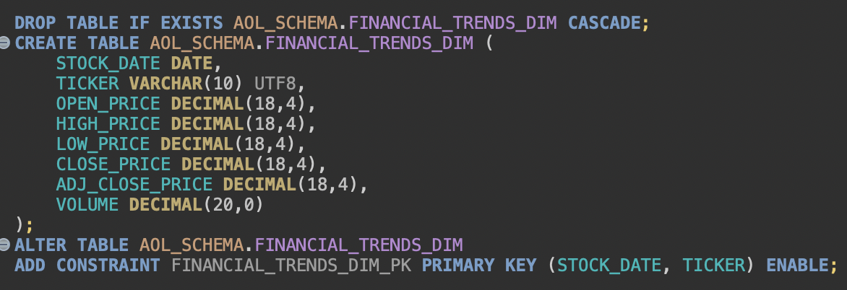
Q5: Market Confidence Validation
Get stock market prices for the 2 major e-commerce brand in the Q2 of 2006
Stock Prices for Apple (AAPL) and Ebay (EBAY) from Yahoo finance for the period of March to May 2006
Perform an ETL process on the stock price data and load into FINANCIAL_TRENDS_DIM to prepare it for the analysis query

Slide 30
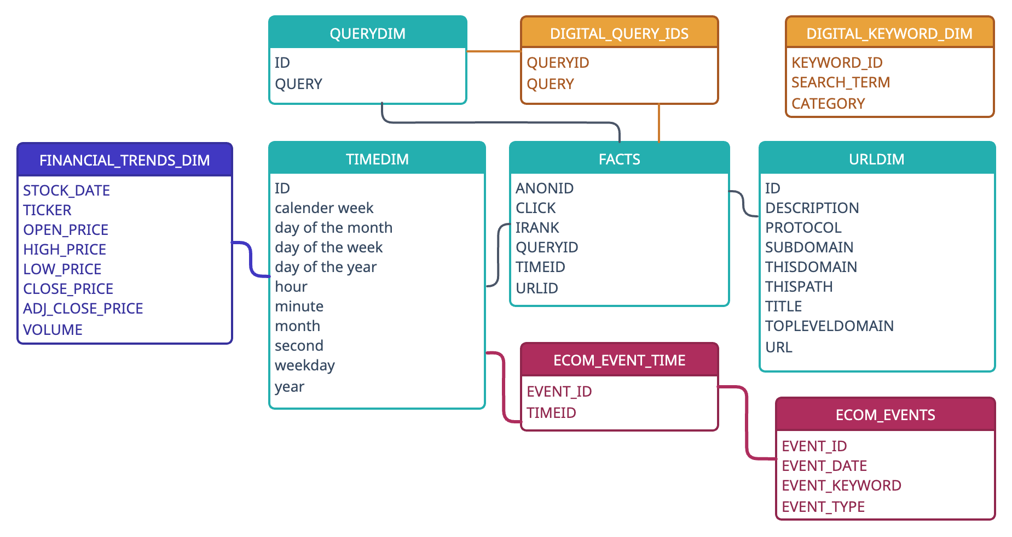
Q5: Extended Schema with real world stock prices of major brands

Slide 31
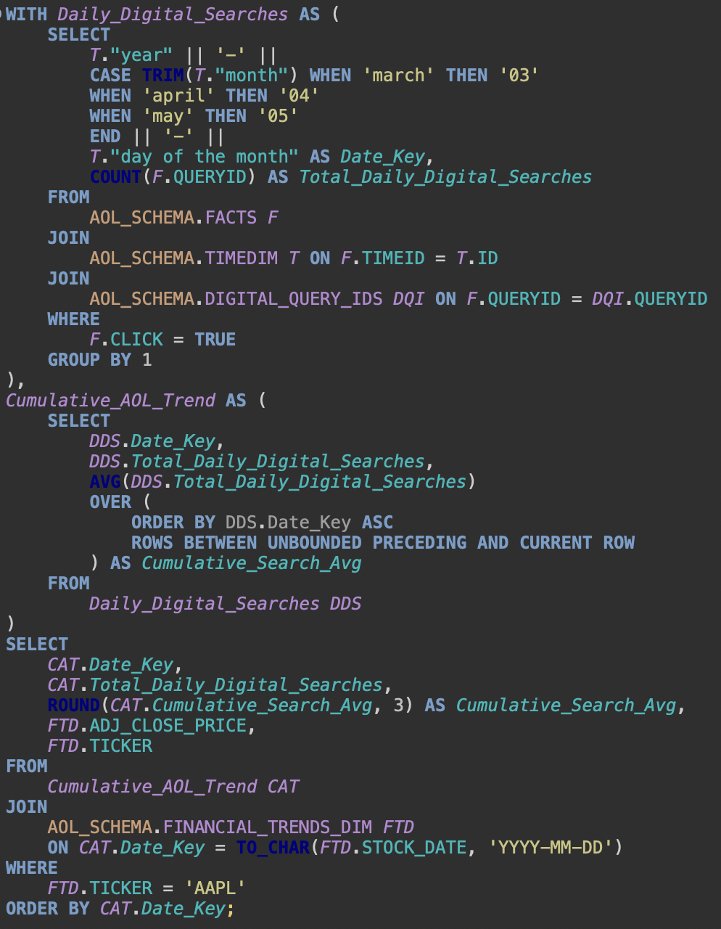
Q5: Market Confidence Validation
Use CTE to get Daily_Digital_Searches and group by the computed date from the TIMEDIM
...another CTE to get Cumulative_AOL_Trend using the Daily_Digital_Searches using the window function and clause ROWS BETWEEN UNBOUNDED PRECEDING AND CURRENT ROW
JOIN FINANCIAL_TRENDS_DIM with date, focusing on one TICKER at a time (AAPL and EBAY)
We wanted to get the Rolling_7Day_Search_Avg instead of Cumulative_Search_Avg but Exasol 6.0.4 does not allow for precise number of PRECEDING, but the current version allows it.

Slide 32
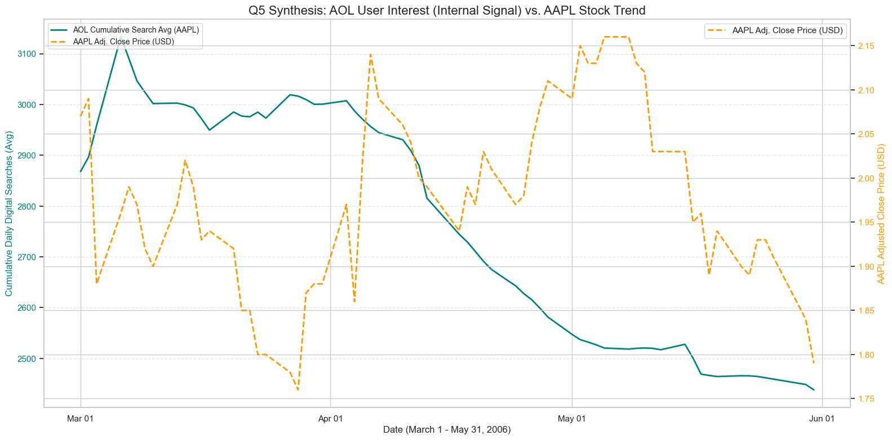
Q5 Synthesis: AOL User Interest as a Financial Indicator (AAPL)

Slide 33
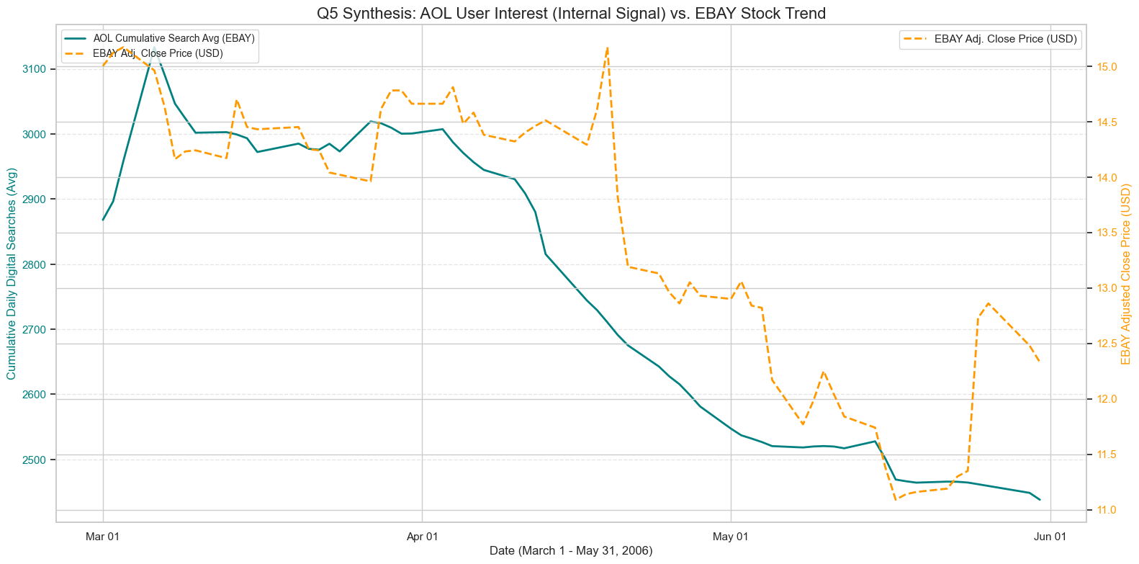
Q5 Synthesis: AOL User Interest as a Financial Indicator (EBAY)

Slide 34
The Cumulative Daily Digital Search Average is a validated leading indicator for investor confidence in digital commerce platforms (AAPL, EBAY). The sustained, downward trend in user interest in late March/early April served as an early warning signal, consistently preceding the subsequent drop in both companies' stock prices. This confirms that user search behaviour was mirroring future market sentiment.
Q5: AOL User Interest as a Financial Indicator

Slide 35

How Effective was AI as a Tool for Data Analysis and ETL?

Slide 36
Gemini AI Model
Aspect | Where AI Excelled | Where Human Oversight Was Critical (Debugged & Corrected)
I. Data Modelling & ETL | Generated the elegant 3NF schema design (e.g., separating ECOM_EVENTS from the ECOM_EVENT_TIME bridge table) to eliminate redundancy. | Failed to correctly handle date component matching for the TIMEID join, requiring manual fix (Year, Month Name, Day) logic.
II. Performance & Optimization | Correctly identified the bottleneck (the slow LIKE '%...%' string join) and created the staging table strategy (DIGITAL_QUERY_IDS) for a permanent performance solution. | Crucial Failure: Repeatedly failed to execute the advanced window operator for rolling averages (ROWS BETWEEN...) due to the Exasol 6.0.4 version limitation. Correction: Required our analytical judgment to pivot to the supported ROWS UNBOUNDED PRECEDING (Cumulative Average).
III. Advanced SQL & Compliance | Formulated complex, multi-operator queries (e.g., ROLLUP for Q1, GROUPING SETS for Q2) and the RANK() OVER (PARTITION BY...) structure, ensuring all technical requirements were met. | Produced a fatal syntax error (K.CATEGORY not found) by using a column from an EXISTS subquery in the SELECT list, requiring me to restructure the query with an explicit multi-way JOIN to fix the visibility error.
IV. Analysis & Presentation | Helped structure the 5-question storytelling flow and provided the visual strategy (e.g., Dual-Axis for Q5, Small Multiples for Q3) for synthesizing complex results. | Generated charts with unreadable labels and flawed scaling, requiring manual intervention (e.g., switching to horizontal bars, using sharey=False) to make the data visually useful.
Mostly used AI model
Notes:
3NF means Third Normal Form (3NF) having a sort of bridge table

Slide 37
Appendix: Questions and OLAP Operators
Q# | Analysis Question | Primary Metric / Focus | Exasol OLAP Operator Used
1 | What was the overall volume and trend of digital content-related searches, and what was the total contribution by month? | Volume & Monthly Contribution | ROLLUP
2 | Which specific digital commerce categories drove the highest click-through rate (CTR), and how did the intent compare based on the hour and day of the week? | Multi-Dimensional CTR & Time | GROUPING SETS
3 | What were the Top 5 most popular destinations (Domains) clicked by high-intent searchers, ranked within each category? | Competitive Domain Ranking | RANK() OVER (PARTITION BY...)
4 | To what extent did key digital commerce product launches or market announcements serve as a demonstrable stimulus for changes in search volume? | Stimulus-Response / Event Correlation | Standard Aggregation & Joins (Utilizes ECOM_EVENT_TIME bridge)
5 | To what extent did the smoothed AOL search trend act as a leading or coincident indicator for the stock price fluctuation of key e-commerce platforms (AAPL, EBAY)? | Financial Correlation / Smoothed Trend | AVG() OVER (ORDER BY... ROWS UNBOUNDED PRECEDING)

Slide 38
Appendix: External Data Sources
Q# | Data Source Name / Type | Content Used & Key Metrics | Data Purpose | URL
Q5 | Financial Market Trend (FINANCIAL_TRENDS_DIM) | Daily Adjusted Close Price (ADJ_CLOSE_PRICE) and Volume for AAPL and EBAY. | Provides the external financial validation to correlate against the AOL search trend. | https://finance.yahoo.com/quote/EBAY/history/?period1=1141171200&period2=1149120000 https://finance.yahoo.com/quote/AAPL/history/?period1=1141171200&period2=1149120000
Q4 | Historical E-commerce Event Timeline (ECOM_EVENTS) | 10 specific dates, keywords in America e-commerce (e.g., Spotify Launch, Amazon S3), and event types from Mar–May 2006. | Measures if external events drove measurable spikes in AOL search volume. | Google Search
Q1, Q2, Q3 | Custom Digital Commerce Keyword List (DIGITAL_KEYWORD_DIM) | List of 10+ high-confidence digital terms and key brand names (e.g., download, iTunes, software). | Used as the foundational filter to create the DIGITAL_QUERY_IDS staging table, ensuring only relevant digital commerce searches are analysed.

Slide 39

https://gitlab.bht-berlin.de/jugaad/bi-aol-assignment
SOURCE CODE

Slide 40


E-Commerce: The trend of Digital Goods in the AOL Dataset 2006
Questions, Answers, Comments, Thoughts ...

